Slide 1
Data Warehouse vs Data Lake

Slide 2
Data warehouse: Purpose & Use cases
Optimized for structured data and complex queries.
Single source of truth for decision purpose
Optimized at querying the Data in it
Data warehouses store historical data, enabling trend analysis over time.

Slide 3
Data lake: Purpose & Use cases
Stores large volumes of raw data in its native format, flexible for various types of data sources.
Data lakes are designed to handle massive amounts of data, making them suitable for big data storage.
They can scale horizontally.
Data lakes encourage innovation and experimentation

Slide 4
The Data Structure

Slide 5
The Data Structure
Data Warehouse
Data is cleaned, transformed, and stored in a predefined schema.
Data warehouses often use a star or snowflake schema to organize data into fact tables
Data Lake
Stores large volumes of raw data in its native format.
A data lake can store structured data, semi-structured data and unstructured data

Slide 6
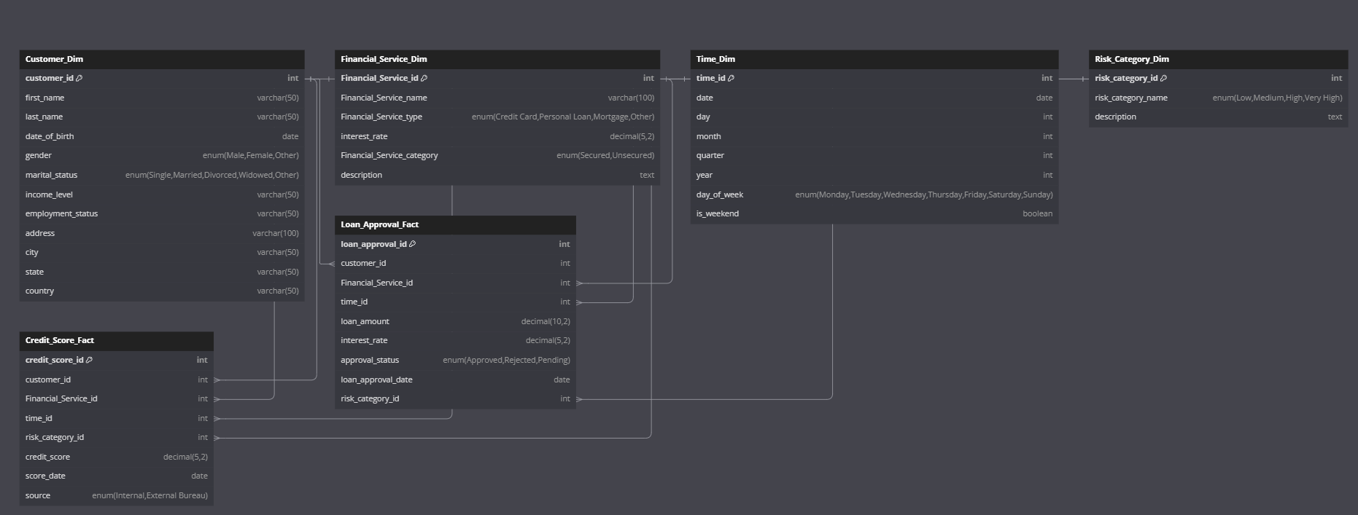
Our Schema for Data Warehouse

Slide 7
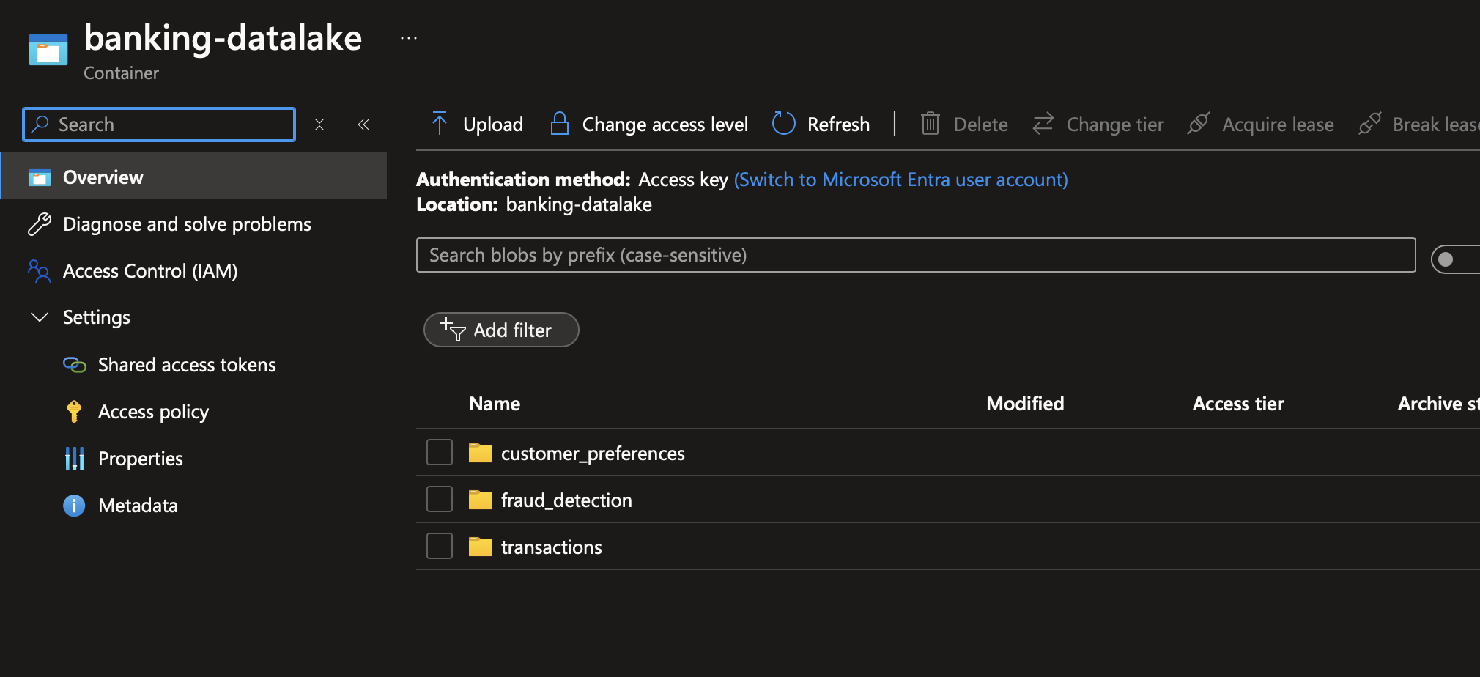
Our Data Lake Structure

Slide 8
The Data Process

Slide 9
The Process
Data Warehouse
ETL (Extract, Transform, Load)
Data is processed before storage.
Data Lake
ELT (Extract, Load, Transform)
Data is processed when needed

Slide 10
Users

Slide 11
Data Warehouse
Business analysts - generate reports, conduct trend analysis, and make data-driven decisions
Data scientists - complex data analysis, often using tools like SQL, to identify patterns, relationships, and key metrics
Decision-makers who need structured data. - Use dashboards and reports, Track progress toward goals, and make informed strategic decisions

Slide 12
Data Lake
Data scientists - Experiment with different data sources and models.
Data engineers - Ingest, store, and manage diverse data types from various sources
Researchers - work with raw, unprocessed data.

Slide 13
Thank You

